Slide 1
Biodegradation and bioremediation in wastewater treatment systems
Greg Gloor
ggloor@uwo.ca
@gbgloor
github.com/ggloor/compositions/presentations

Slide 2
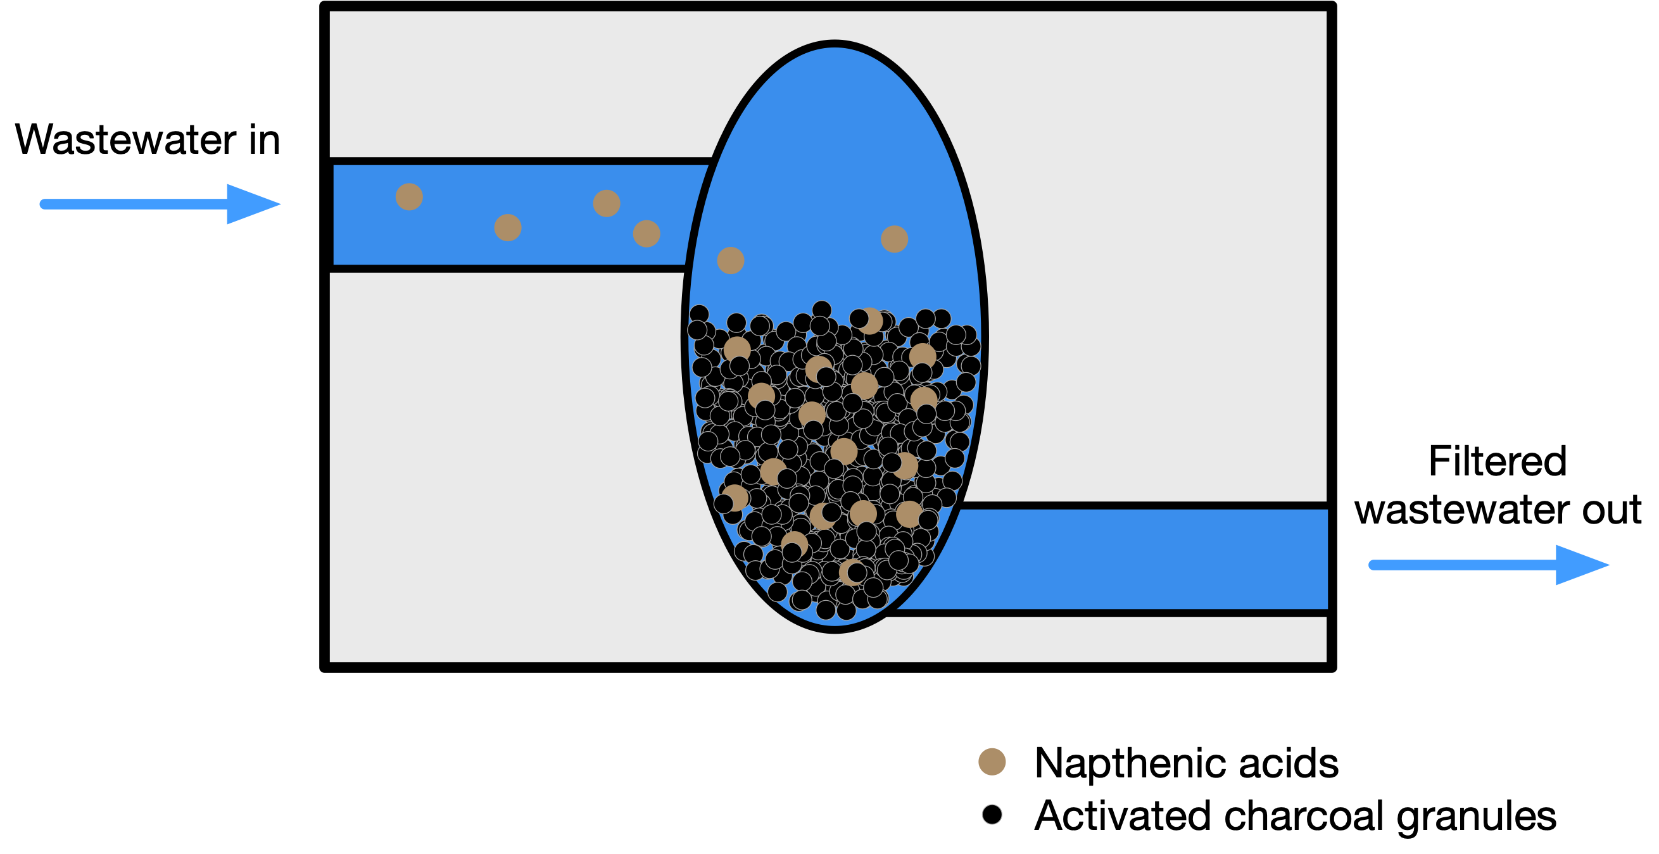
Problem: Activated charcoal filters (Suncor)
Notes:
Physical and biodegradation methods can be used smaller scale refineries.
Perfect for us because it enriches both naphthenic acids and bacteria that degrade them
Wastewater in, adsorption, wastewater out.
How does this community degrade naphthenic acids, and how can we manipulate them to do it faster?

Slide 3
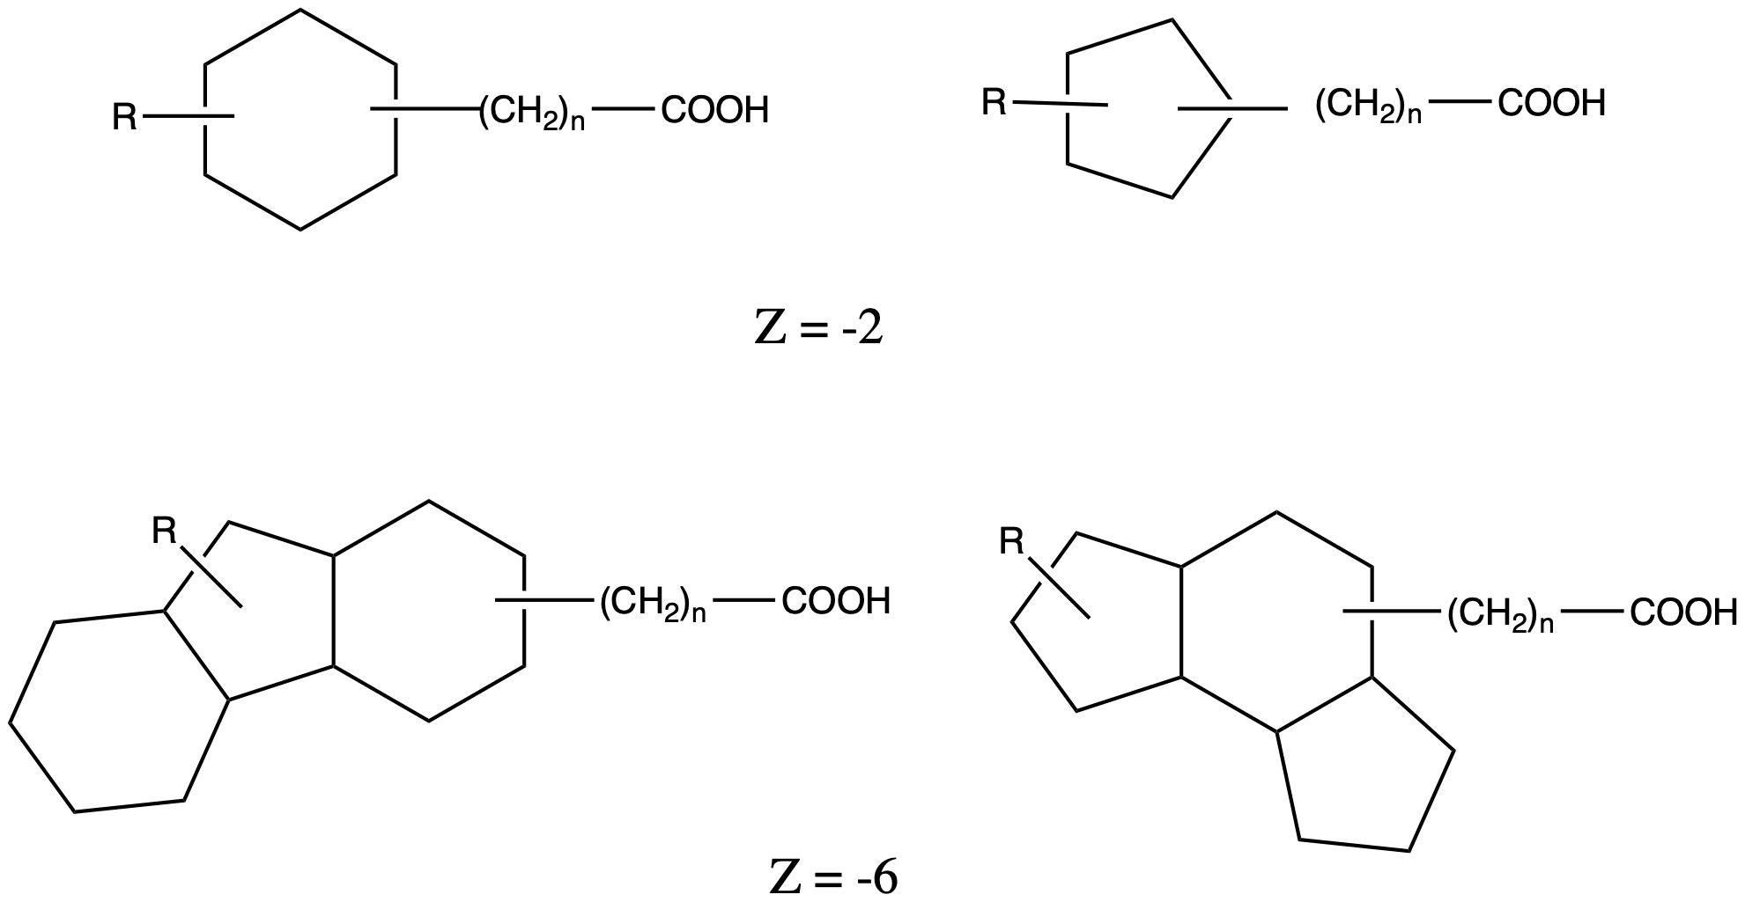
Napthenic acids
Significant environmental toxin
1 billion m³ naphthenic acid-containing wastewater annually
Known that bacteria biodegrade naphthenic acids over time when concentrated
Naphthenic acids
Notes:
Oil refinement generates naphthenic acids
Naphthenic acids are toxic to the environment
There are lots of naphthenic acids in Canada especially
Naphthenic acids are known to be biodegraded over long periods of time (very slow)
Too expensive to treat tailings ponds chemically or physically, best option is biodegradation
We know how single bacteria can degrade single compounds, but in reality it is a complex community all contributing to degrading thousands of compounds
We know how single bacteria degrade single compounds, but how does this community of bacteria degrade this complex group of compounds?

Slide 4
Functionalizing meta-seq ‘omes
A sequence is a sequence is a sequence until it is annotated
Fernandes et al. 2014. Unifying the analysis of high-throughput sequencing datasets: characterizing {RNA}-seq, 16{S} r{RNA} gene sequencing and selective growth experiments by compositional data analysis. Microbiome
Gloor et al. 2017. Microbiome Datasets Are Compositional: And This Is Not Optional. Frontiers in Microbiology
Macklaim & Gloor 2018. From RNA-seq to Biological Inference: Using Compositional Data Analysis in Meta-Transcriptomics. Meth. Mol. Bio.
Gloor, Macklaim, Fernandes, 2016. Displaying Variation in Large Datasets: Plotting a Visual Summary of Effect Sizes. J. of Comp. and Graph. Statistics

Slide 5
Meta-transcriptome of refinery aeration basin
grown in two carbon sources
Each point is a gene (>250k)
Y-axis is difference between groups
X-axis is dispersion within group
Lysinbacillus prefers alkanes
NA
ALK

Slide 6
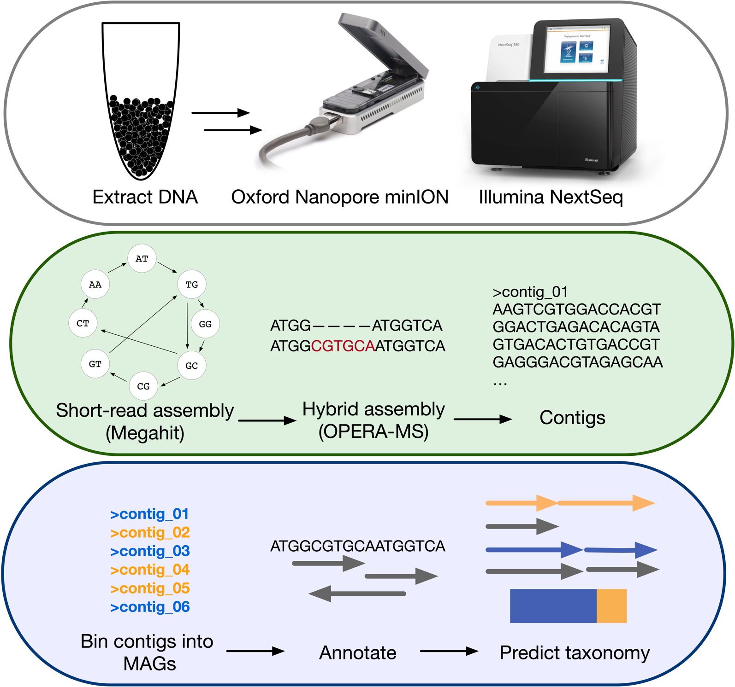
What are we missing?
Less than 10% of the reads map to known bacterial species
Need to identify who is there before asking what they are doing
MAGs are best way to do this
MAGs from short reads only are incomplete and artificial

Slide 7
Protocol: MAGs that rival single isolate QC!
Giguere DJ, et al. Complete and validated genomes from a metagenome. bioRxiv, 2020

Slide 8
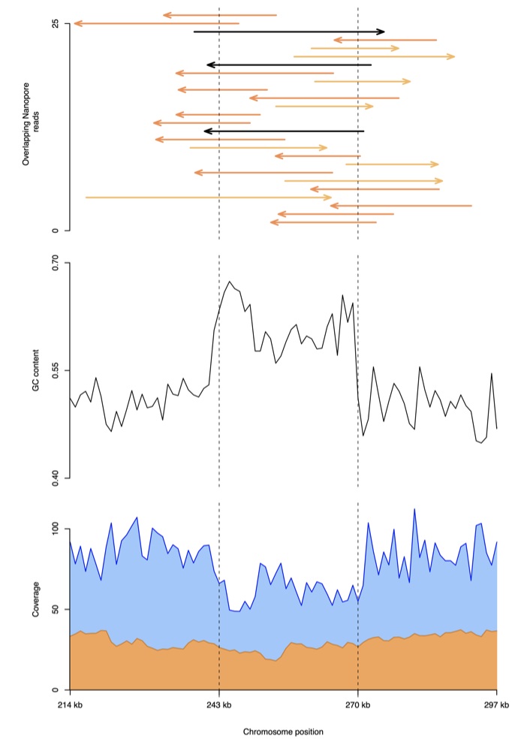
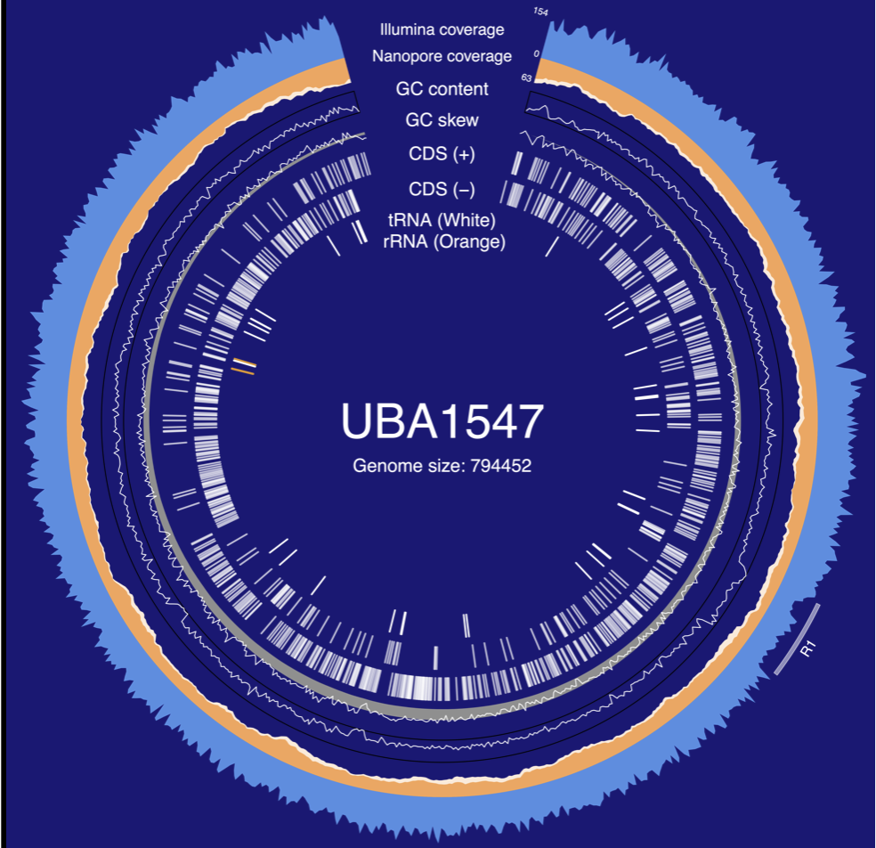
UBA1547 – genome plasticity

Slide 9
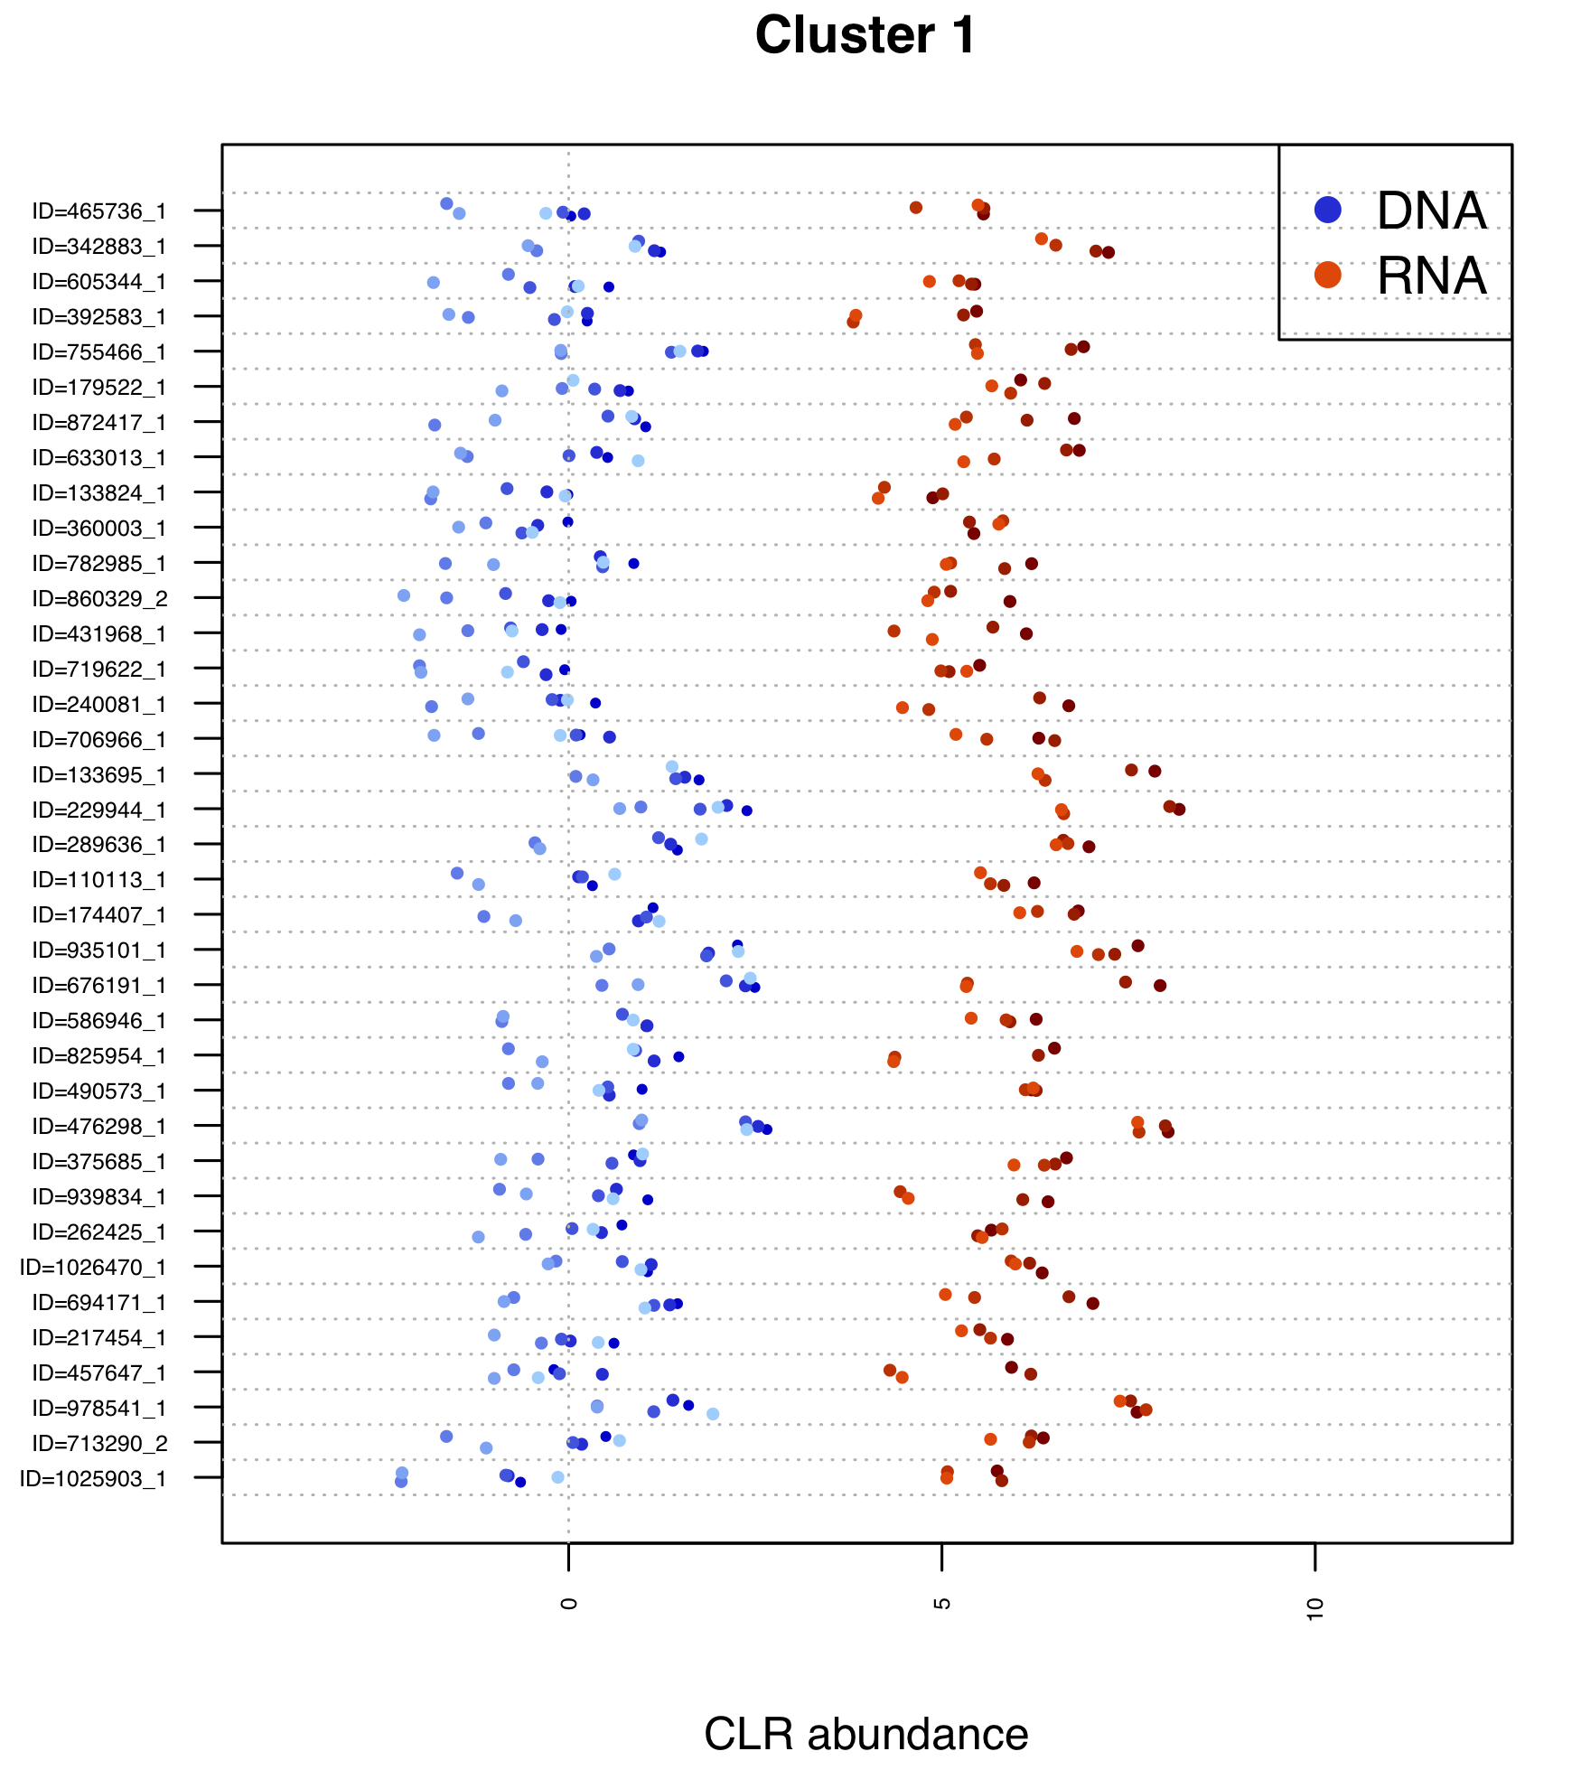
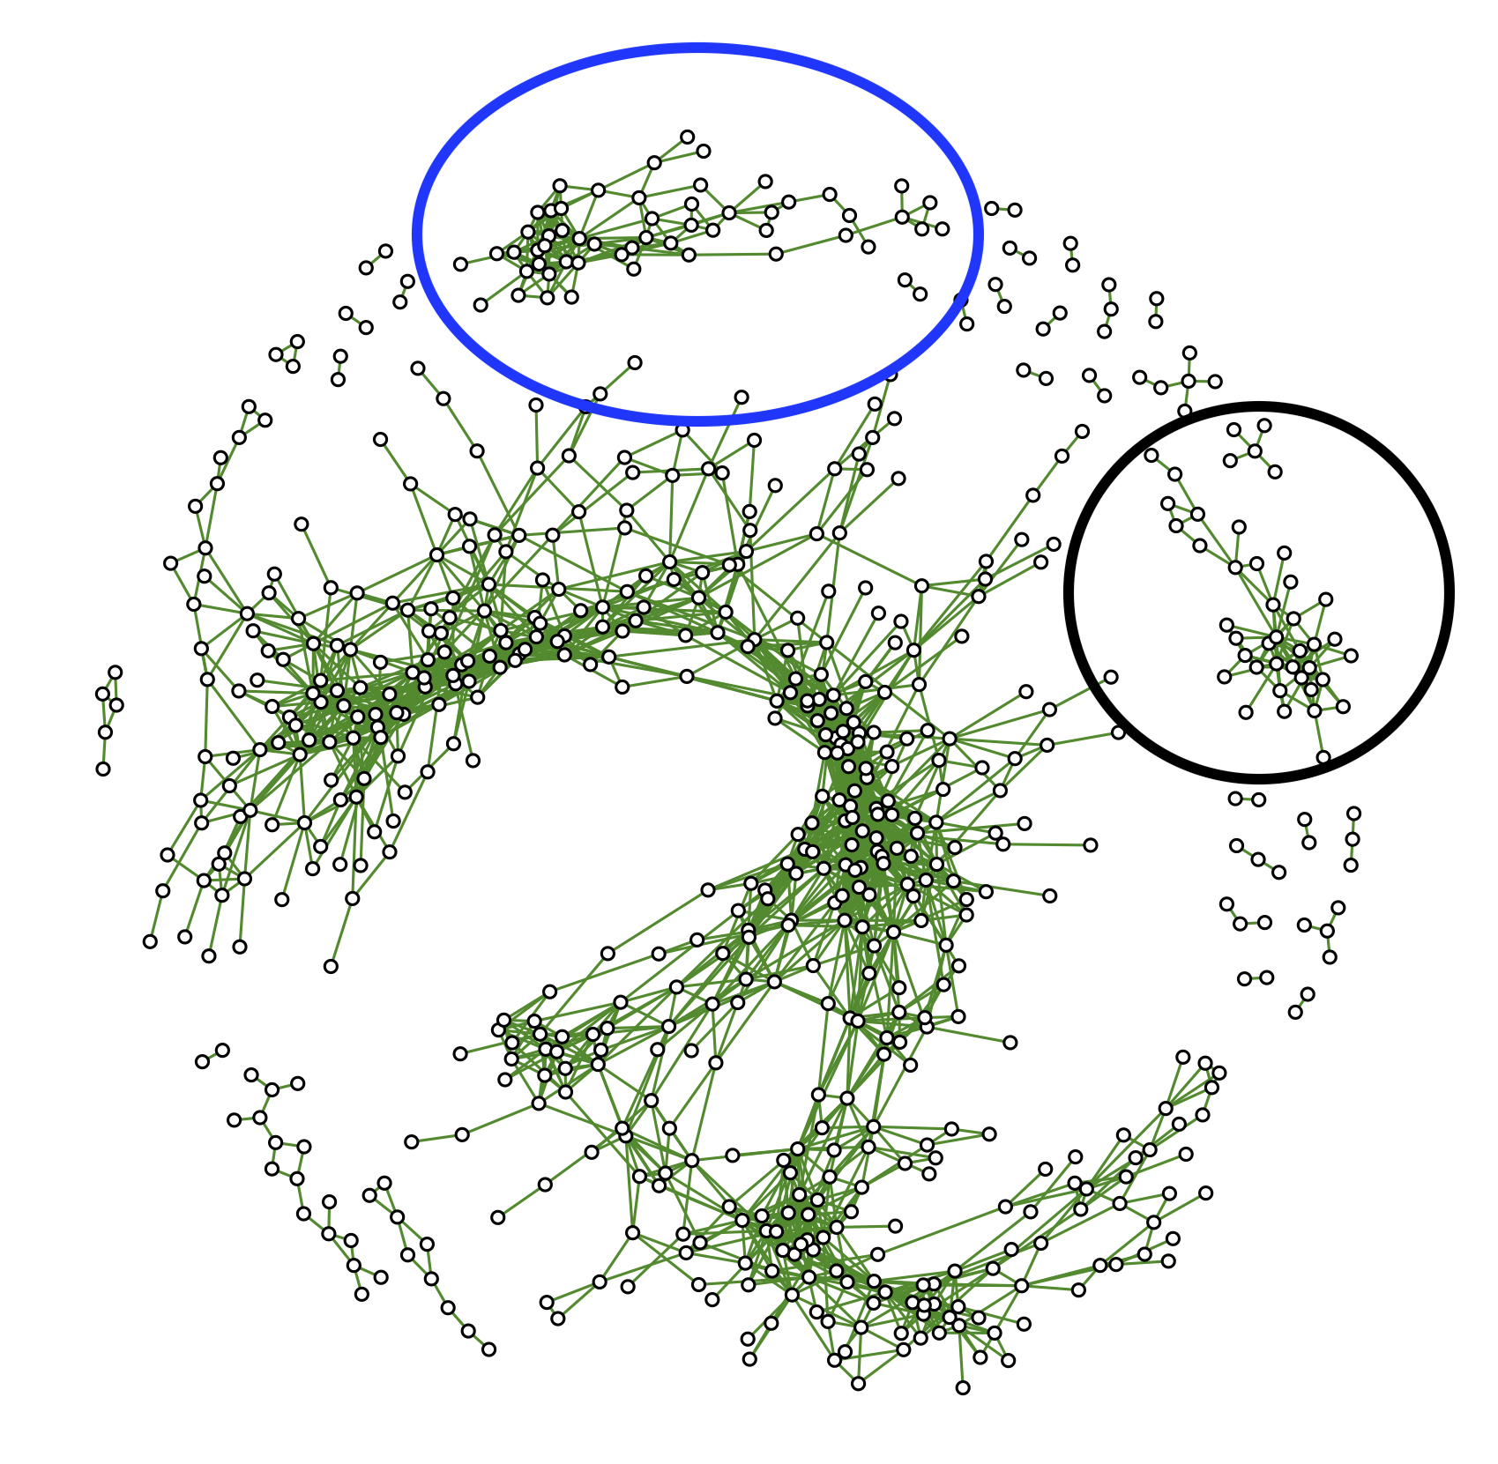
How does this help?
ORFs associated with hydrocarbon degrading genes circled in blue and black
ORF = open reading frame

Slide 10

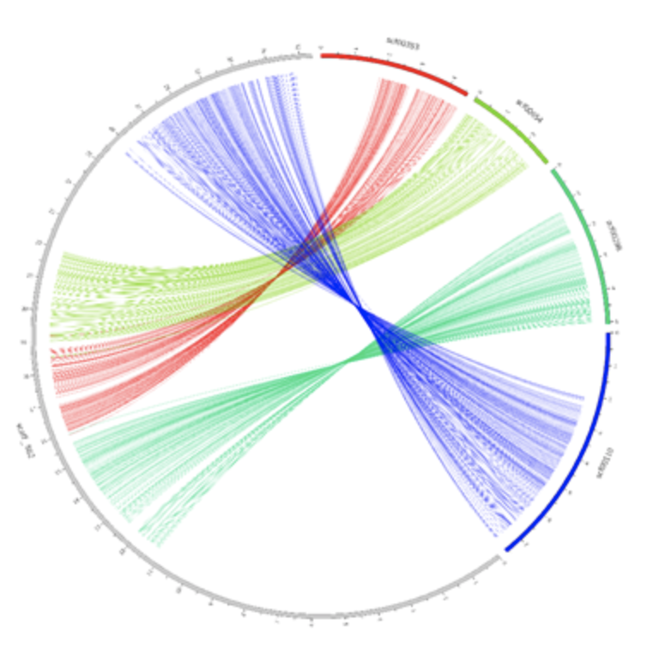

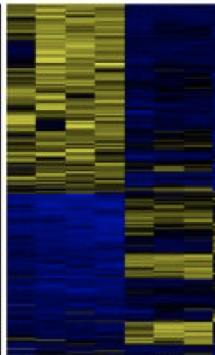
Next steps?
Full catalogue of genes/genomes
Syntenic regions / operons
Plasmids and phage
Meta-transcriptome of NA enriched cultures
Synthetic beneficial communities for remediation

Slide 11

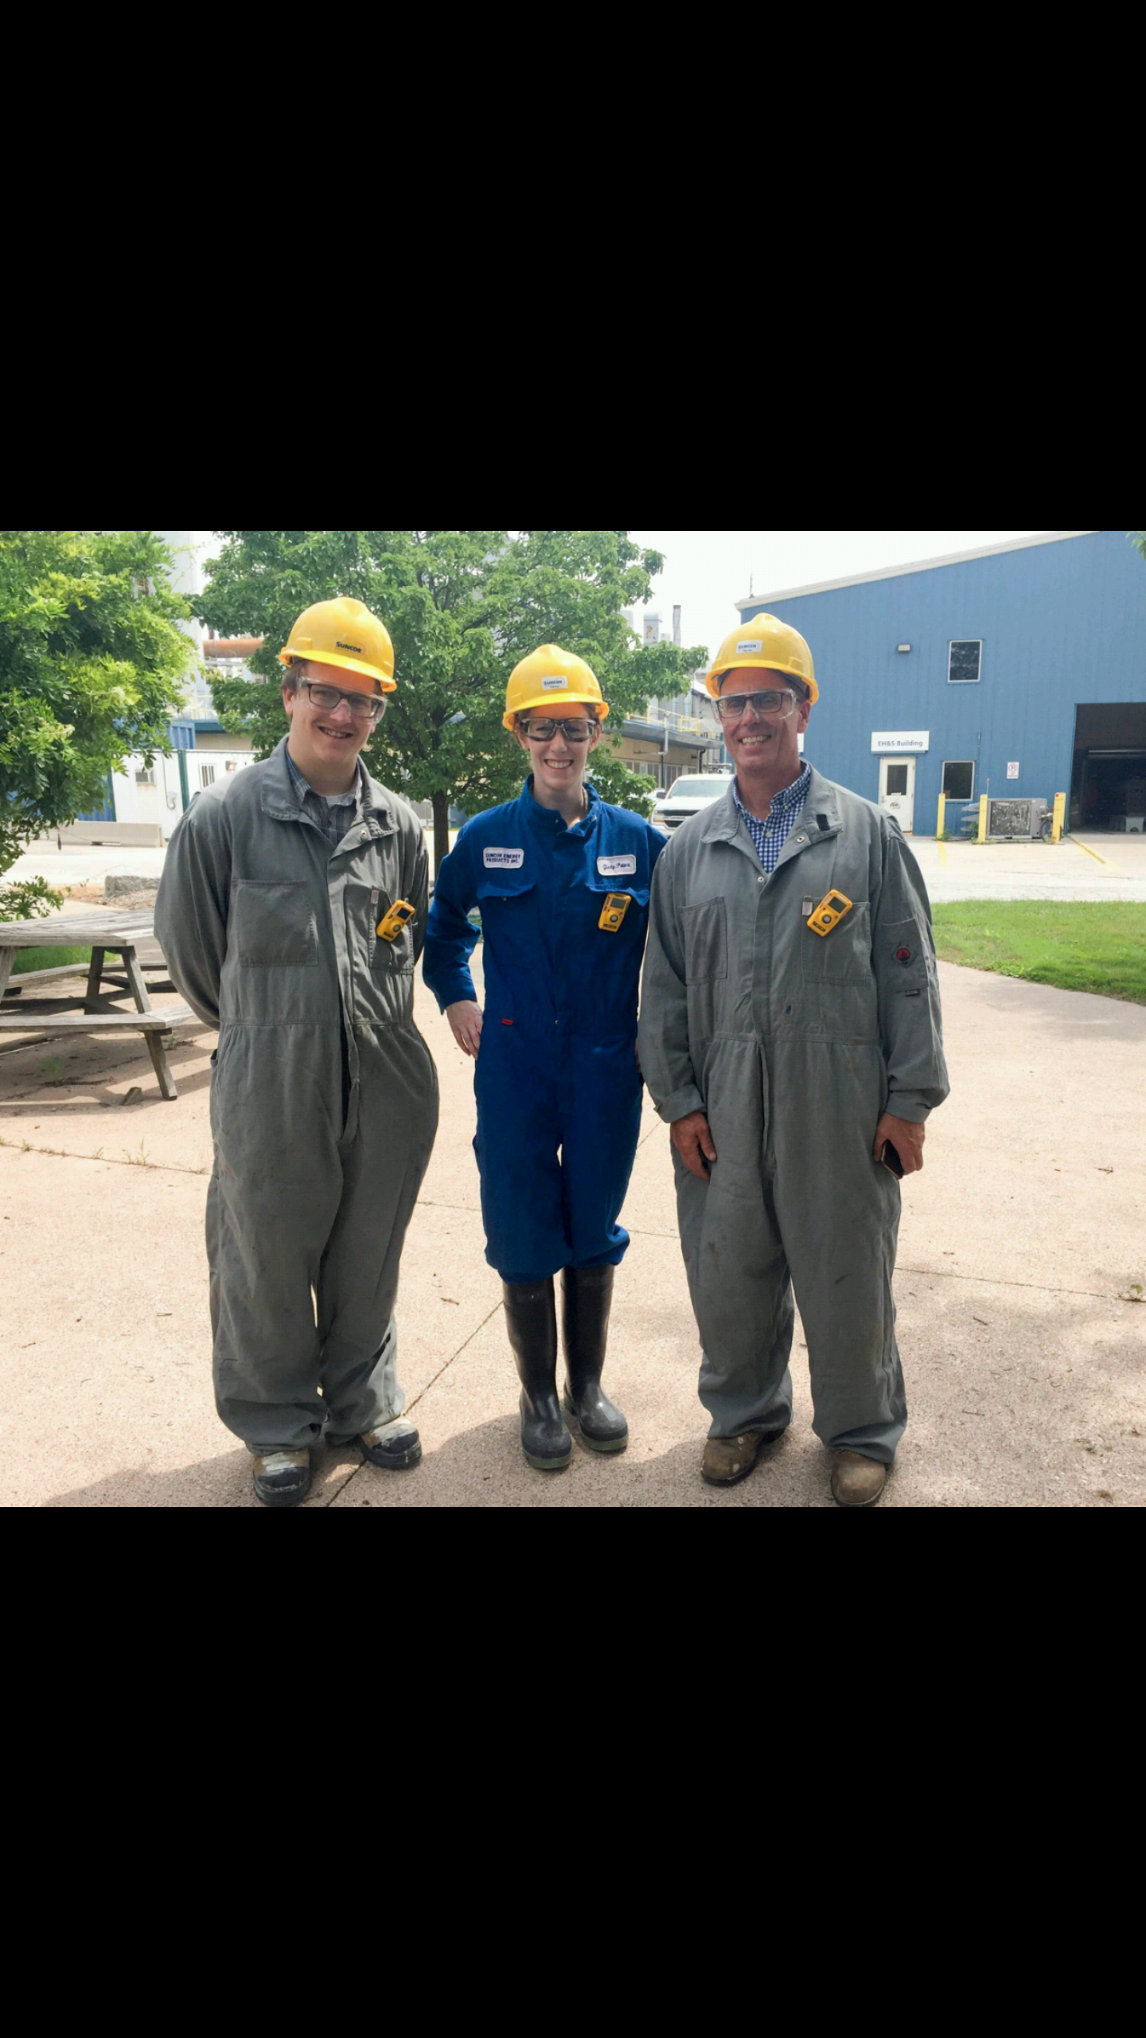


Acknowledgements
https://github.com/dgiguer/complete-and-validated-genomes-from-a-metagenome
Dan Giguere
Alec Bahcheli
Ben Joris
Brandon Lieng
Dave Edgell
Jean Macklaim
Tom McMurrough
Funding:
Ontario Graduate Scholarship
Martin Flatley
Github: dgiguer
DanielJGiguere | gbgloor

